Slide 1
PART
ONE
Introduction

Slide 2

Assisted suicide:
A right or a wrong?
Unit 7 Law and Morality
iEnglish Book 2

Slide 3

Learning Objectives
1
1
Knowledge
2
Refute in a COUNTER PARAGRAPH
Skill
3
Critical thinking

Slide 4
How to Refute
Ideas
Language
Sentence patterns: It is argued that/ Supporters of... claim that...
Expressions: inflict no harm on others, have an obligation to; pose a threat to, violate the right of...
Structure
Opposing argument + granting merits + rebuttal
PEEL (point, elaboration, example, link)

Slide 5
Voice your views
Opposing argument |  | It is argued that terminally ill patients should be allowed assisted suicide as long as they inflict no harm on others.
Granting merits |  | It seems true that...
Rebuttal | P | However, ...
 | E | It poses a threat to the lives of innocent persons and may violate the rights of doctors and nurses.
 | E | For example, ...
 | L | Thus it is unwise to legalize assisted suicide.

Slide 6

Evaluation

Slide 7
PART
TWO
Teaching
demo

Slide 8

Pros and Cons

Slide 9
Pros
Supporters of legislation legalizing assisted suicide claim that all persons have a moral right to choose freely what they will do with their lives as long as they inflict no harm on others. (Para.3)
Furthermore, it is argued, we ourselves have an obligation to relieve the suffering of our fellow human beings and to respect their dignity. (Para.4)

Slide 10
Cons
Those who oppose any measures permitting assisted suicide argue that society has a moral duty to protect and to preserve all life. (Para.5)
Further, opponents of assisted suicide claim that society has a duty to oppose legislation that poses a threat to the lives of innocent persons. (Para.6)
Finally, it is argued that sanctioning assisted suicide would violate the rights of others. (Para.7)

Slide 11

Sentence Patterns
To introduce an argument
Supporters/ Opponents of ...argue/ claim that ...
Those who support/ oppose ... argue/ claim that...
It is (often) argued/ claimed that ...

Slide 12
How to refute?
Supporters of ...argue that ...
It is argued that ...
It poses a threat to the lives of innocent persons.
It inflicts no harm on others.
It may violate the rights of doctors and nurses.

Slide 13

How to refute?
Opposing argument
A
It is argued that...
It seems true/ plausible that...
Granting merits
B
Rebuttal
PEEL
C

Slide 14

How to refute?
P
E
E
L
Point
Elaboration
Example
Link
A
However/ Nevertheless...
A
For example/ For instance...
A
In addition/ Not only...but also...
A
Thus/ Therefore...

Slide 15
How to refute?
Opposing argument |  | It is argued that terminally ill patients should be allowed assisted suicide as long as they inflict no harm on others.
Granting merits |  | It seems true that...
Rebuttal | P | However, ...
 | E | It poses a threat to the lives of innocent persons and violates the rights of medical workers.
 | E | For example, ...
 | L | Thus...

Slide 16

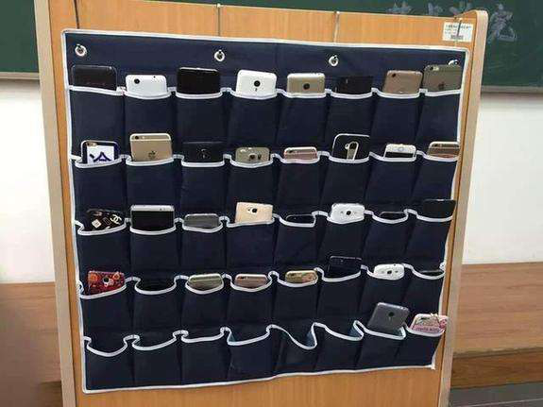
Should smartphone use be allowed in class?

Slide 17
You are on the pro side
Opposing argument |  | It is argued that smartphone use in class can eventually ruin students' school work.
Granting merits |  | It seems plausible that...
Rebuttal | P | However, ...
 | E
 | E | For example, ...
 | L | Thus...
The smartphone has become a necessity in a smart classroom.

Slide 18

Why a counter paragraph?
Strong argument

Slide 19
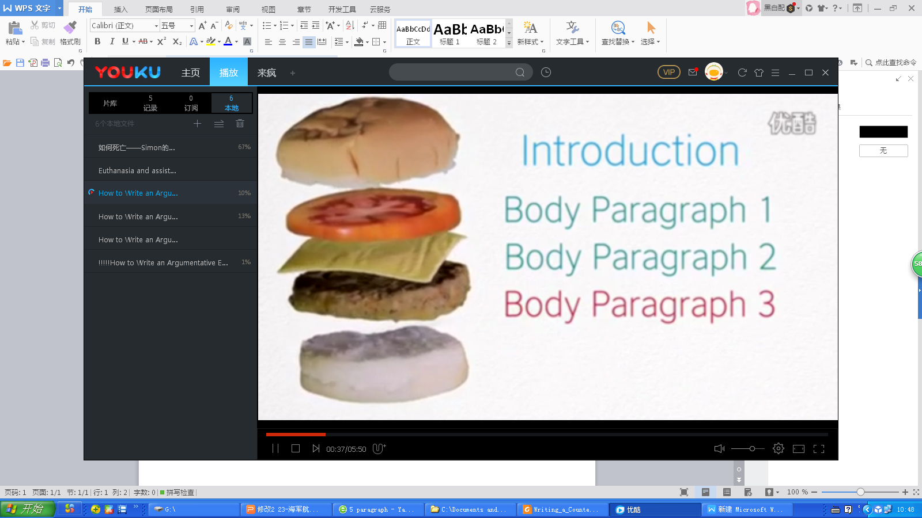
A Five-paragraph Format
Introduction
1
2
Developing your argument 1
3
Developing your argument 2
4
Refuting an opposing argument
5
Conclusion

Slide 20

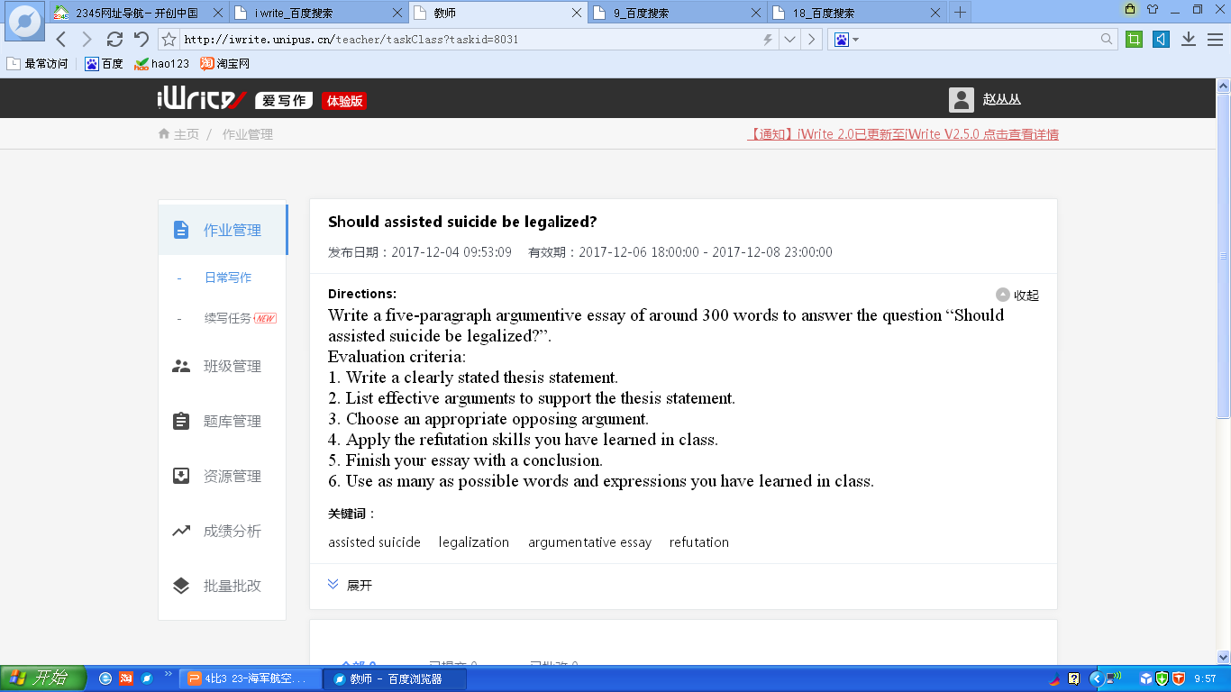
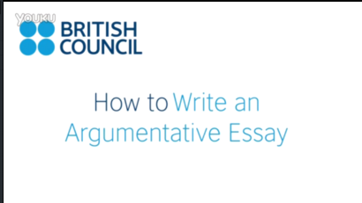
Assignment

Slide 21
Assignment
Checklist
Have I put forward a clearly stated thesis?
Are my arguments effective in supporting the thesis?
Have I considered possible opposing views?
Have I granted the mertis of the opposing argument?
Have I properly signaled my refutation?
Have I used PEEL in my refutation?
Have I used the expressions learnt in the text?
Have I come up with some creative ideas?

Slide 22

Thank You

